Slide 1
Results description
SimNet Modelling Subgroup Friday, 15. May

Slide 2
Introduction
Biodiversity and ecosystem functioning (BEF) is context dependent
This context-dependency is mediated by:
The degree to which the most competitive species also produce the most biomass
Tradeoffs between local and regional community assembly
Our question:
How does biodiversity and ecosystem functioning (in our case biomass) change with local and regional assembly processes?

Slide 3
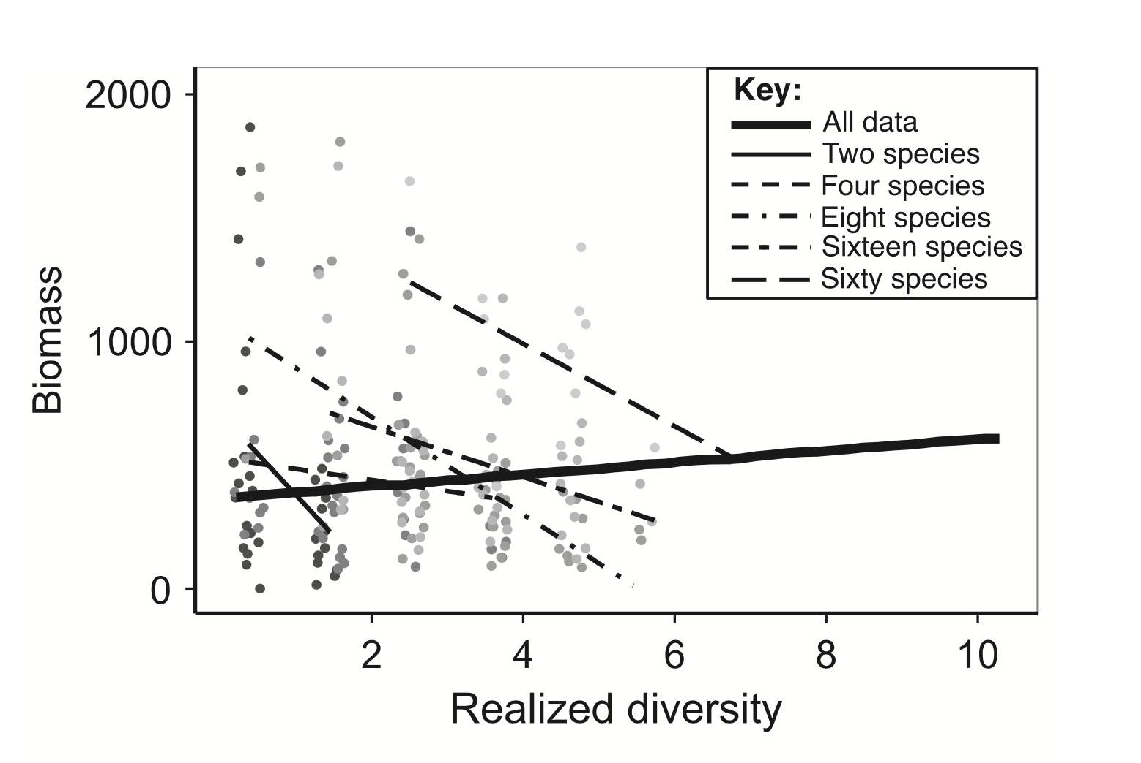
Study case – Leibold et al. 2017

Slide 4
Simulation experiment
Modelled after the Jena Experiment
Different species richness treatments (monoculture, 2, 4, …, 64)
Two stages:
With seed dispersal from the metacommunity (”metacommunity stage”)
Without seed dispersal (“isolation stage”)

Slide 5
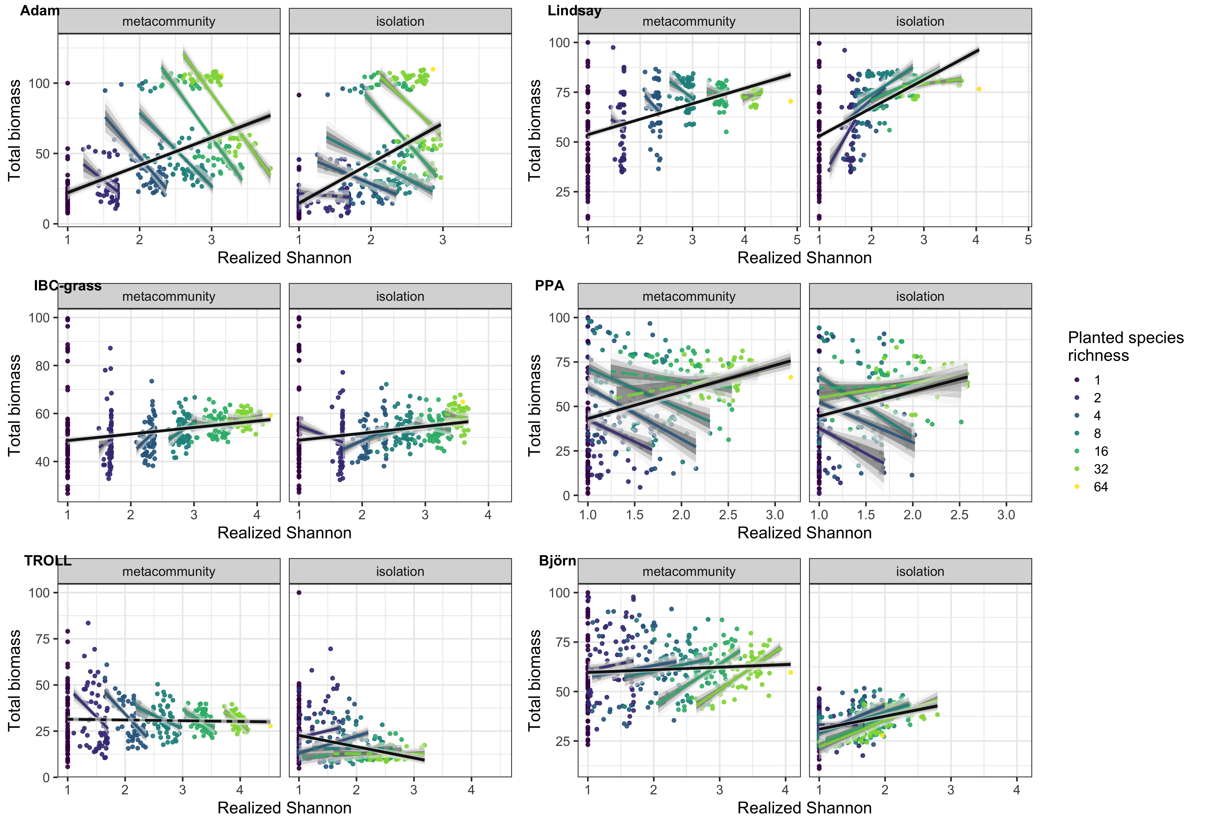
Diversity’s effect on Biomass
Notes:
Metacommunity phase:
Pattern similar to Leibold in Adam, Lindsay, and PPA: Positive biodiversity-biomass relationship overall, but negative within-treatment slopes.
In TROLL and Björn, this main effect is absent.
In TROLL, the within-treatment slopes are negative however
IBC-grass and Björn both in their within-treatment slopes, because IBC-grass uses NDD, and Björn has resource partitioning in which when there is low diversity, niches are left empty.
Isolation phase:
Models’ slopes generally become more positive
Lindsay’s and TROLL’s within-treatment slopes become more positive
Adam’s becomes less negative
In Lindsay’s, for example, seed addition inhibits the high-biomass-producing species. The removal of this leads to a more positive within-treatment effect.
As a very competitive but low biomass species comes to dominate the communities in TROLL, the relationship between diversity and becomes negative. In higher-diversity mixtures, the chance that this species in incorporated in the mixture increases. It comes to dominate the community and reduce total biomass.
We suggest that a key mechanism underlying this diverse array of behavior is the correlation between species’ biomass in monoculture and their biomass in mixture.
If a species has a high biomass in monoculture and performs well in mixture, it will tend to dominate the community and increase the total biomass. However,
When the most competitive species do not perform well in monoculture, they will dominate the community but leave it in a low-biomass state.
First, we inspect the patterns of correlation between monoculture and mixture biomass.

Slide 6
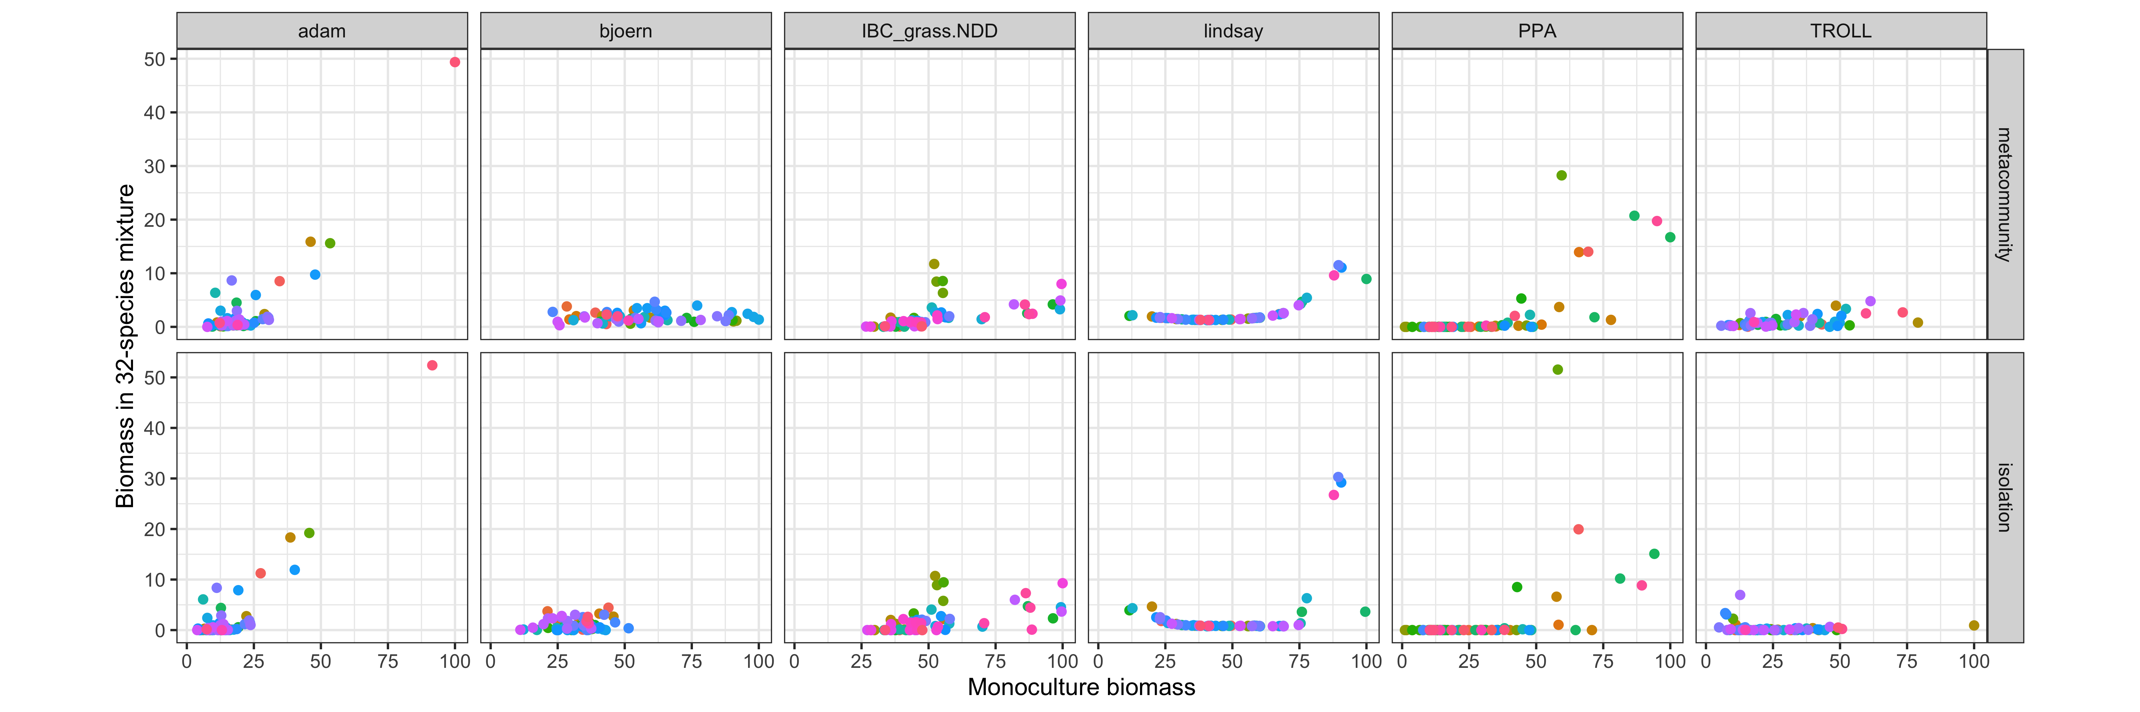
Correlations of monoculture to mixture biomass
Notes:
All the simulations have different correlations between their monoculture and mixture biomasses. Adam’s, by design, is very strongly correlated. In TROLL, you can see that a low monoculture-biomass species comes to dominate the community without external seed addition.

Slide 7
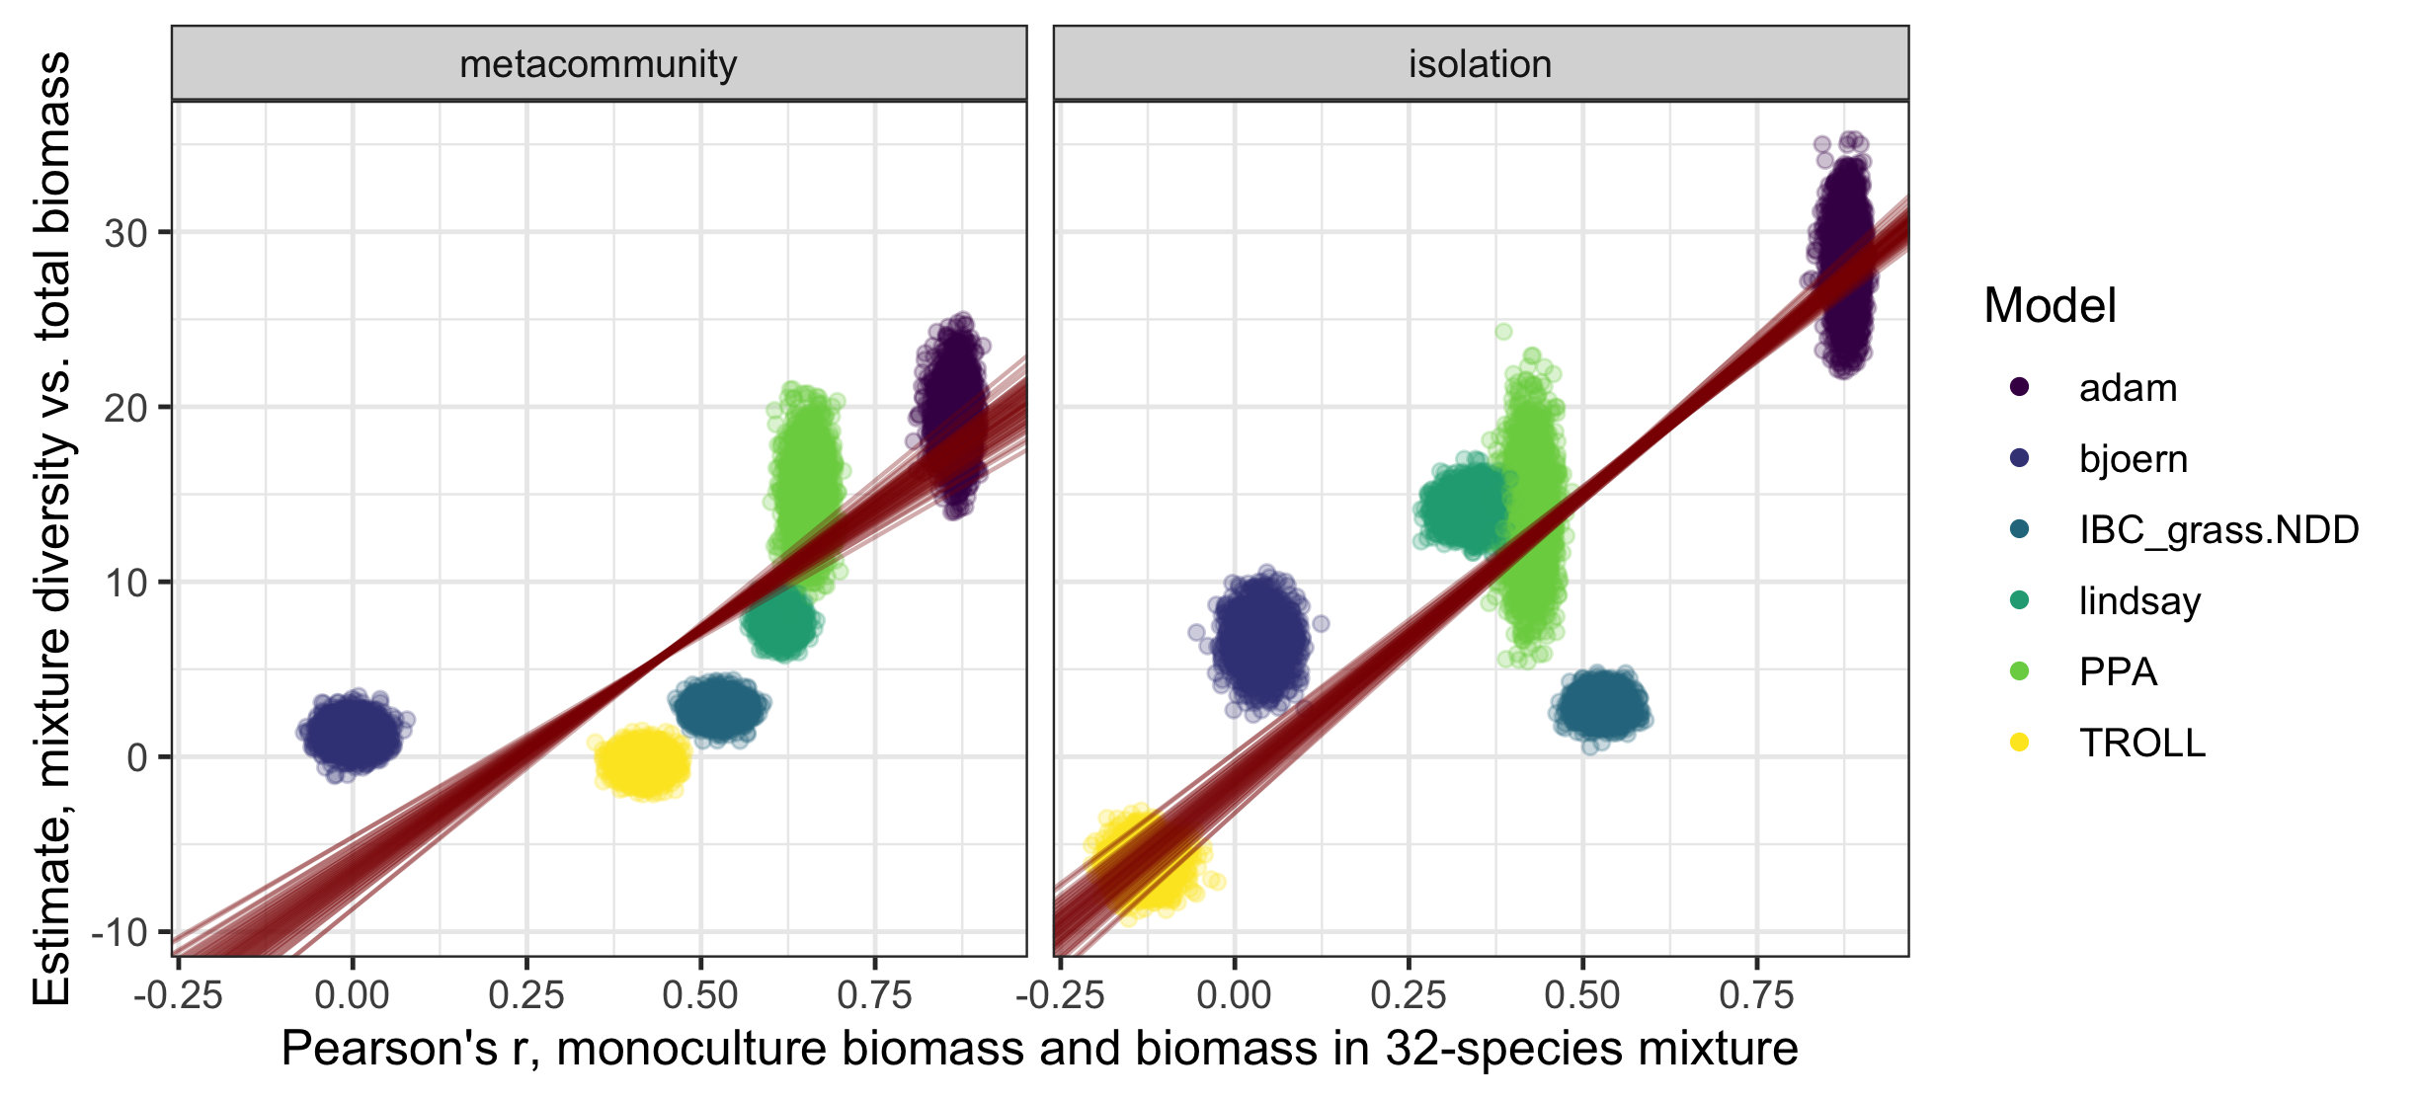
The stronger species' monoculture biomasses are correlated to their mixture biomasses (competitive strength), the stronger the selection effect across treatments, and …
Notes:
So we put these two datasets together.
First, the main effect:
Bootstrapped both Pearson’s correlation coefficients between monoculture biomass and mixture biomass, and the estimates that we derived describing the main (bold line) relationship between diversity and biomass.
We find a positive relationship, meaning that in simulations with a higher correlation between a species’ competitive strength and their mixture biomasses, the stronger the main relationship between diversity and biomass.
When the metacommunity includes more species, the chance that a high-biomass producing species is included in the mixture increases.
Interestingly, when you remove seed addition this relationship tends to become more extreme. This is because without seed addition, the plants that don’t contribute to biomass – but are supported by seed addition – are extirpated.

Slide 8
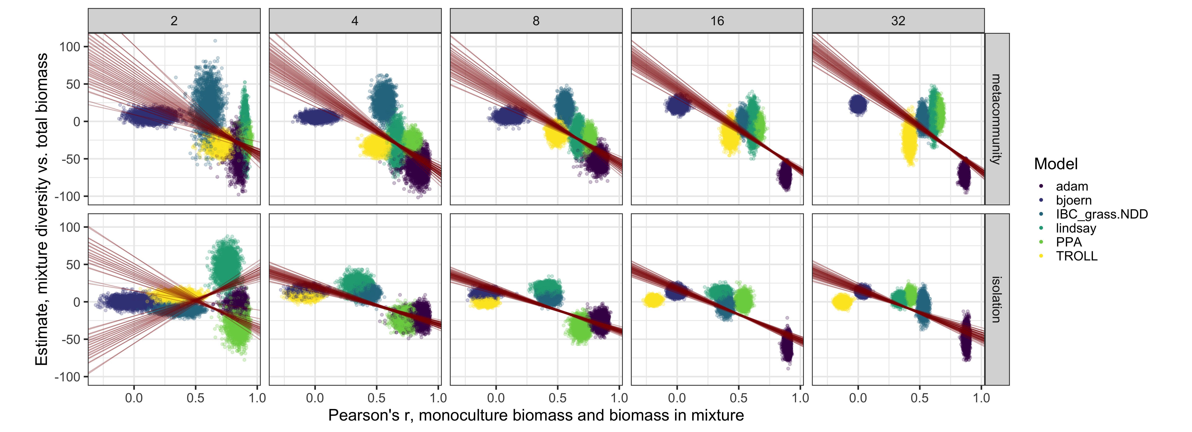
… the more negative the within-treatment relationships (competitive exclusion of low-biomass species)
Notes:
However, when you look at the treatment effects, the opposite is the case.
This is for the same reason: When a species’ biomass and competitiveness are tightly correlated, the most competitive (and high biomass) species will tend to dominate the communities. If you control for the size of the metacommunity, then, there will tend to be a negative relationship between biomass and diversity.
This is because the communities that have high diversity tend to not produce much biomass, because they are filled with species that aren’t very competitive.
Interestingly, when you remove the metacommunity, this relationship becomes less negative. This mirrors what occurs in the main (across treatment) effect. Because seed addition tends to increase diversity, those communities whose diversity is being bolstered by seed addition will become less diversity – and consequently, have higher biomass. Without these low-diversity communities, the relationship between diversity and biomass becomes less extreme.

Slide 9
Discussion
Did we correctly interpret your model’s results?
Are any steps of our methodology unclear?
Do you have any insights or connections to the literatures that we overlooked?

Slide 10
Hopeful timeline
Manuscript writing (Mike, Katie, Adam, Nadja) in May and early June
Distribution to coauthors in mid-June
Meeting with larger SimNet group in mid-June
Submission in July/August

